Slide 1



OOP - Advanced
Polymorphism - Interfaces
SoftUni Team
Technical Trainers
Software University
http://softuni.bg

Slide 2
Questions
sli.do #PHP-WEB

Slide 3
CheckList
Classes & Objects
Inheritance
Encapsulation
Visibility, Getters & Setters, Magic methods
Abstract Classes

Slide 4
Repair List
IDE
Property type hinting
Generate
Multibyte
Static
Has-a vs Is-a

Slide 5
Has-a vs. Is-a
A House is a Building (inheritance)
A House has a Room (composition)
A House has an occupant (aggregation)

Slide 6


Table of Contents
Interfaces
Basic usage
Multiple interfaces
Multiple interfaces with multi implementations

Slide 7
Fundamental Principles of OOP
Abstraction
Hide complexity
Encapsulation
Hide internal data
Inheritance
Inherit members from parent class
Polymorphism
Different functionality while sharing a common interface

Slide 8

Why I need a Polymorphism ?

Slide 9
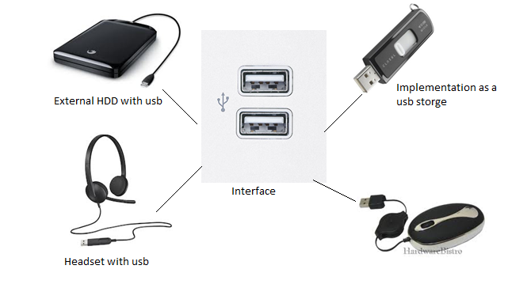
Interfaces

Slide 10
Interfaces
An integral part of polymorphism is the common interface.
Defining an interface is easy
Attach it to a class using the implements keyword
interface MyInterface {
// methods
}
class MyClass implements MyInterface {
// methods
}
Notes:
But they can be subclassed.

Slide 11
Interface details
Interfaces can be extended like classes using the extends operator.
The class implementing the interface must use the exact same method signatures as are defined in the interface
Interfaces can have constants.
Interface constants works exactly like class constants except they cannot be overridden by a class/interface that inherits them.

Slide 12
Interfaces Example
Methods can be defined in the interface just like in a class, except without the body
All methods defined here will need to be included in any implementing classes exactly as described
All methods declared in an interface must be public
interface MyInterface {
public function doThis();
public function doThat();
public function setName($name);
}
Notes:
But they can be subclassed.

Slide 13
Interfaces Valid Example
class MyClass implements MyInterface {
protected $name;
public function doThis() {
// code that does this
}
public function doThat() {
// code that does that
}
public function setName($name) {
$this->name = $name;
}
}
All methods included correctly

Slide 14
Interfaces Invalid Example
class MyClass implements MyInterface {
// missing doThis()!
private function doThat() {
// this should be public!
}
public function setName() {
// missing the name argument!
}
}
All methods not included correctly

Slide 15
Identify the Problem
Imagine that you have an Article class that is responsible for managing articles on your website
class Article {
public $title;
public $author;
public $date;
public $category;

Slide 16
Identify the Problem (2)
public function __construct($title, $author, $date, $category = 0) {
$this->title = $title;
$this->author = $author;
$this->date = $date;
$this->category = $category;
}
}

Slide 17
Identify the Problem (3)
Now you want to add a method to output the information into different formats, such as XML and JSON
You might be tempted to do something like this
class Article {
public function write($type) {
$ret = '';
switch($type) {
case 'XML':
$ret = '<article>';
$ret .= '<title>'.$this->title.'</title>';
Using switch to determine type is ugly, do not do this

Slide 18
Identify the Problem (4)
$ret .= '<author>'.$this->author.'</author>';
$ret .= '<date>'.$this->date.'</date>';
$ret .= '<category>'.$this->category.'</category>';
$ret .= '</article>';
break;
case 'JSON':
$array = ['article' => $this];
$ret = json_encode($array);
break;
}
return $ret;
}
}

Slide 19
What is the Problem with This Solution?
This is kind of an ugly solution, but it works - for now
Ask yourself what happens in the future, though, when we want to add more formats?
You can keep editing the class, adding more and more cases, but now you're only diluting your class
One important principle of OOP is that a class should do one thing, and it should do it well

Slide 20
Solution: Define Your Interface
Let's define a public write() method that accepts an Article object as an argument
Any classes implementing the Writer interface will be sure to have this method
interface Writer {
public function write(Article $obj);
}

Slide 21
Solution: Create Your Implementation
class newXMLWriter implements Writer {
public function write(Article $obj) {
$ret = '<article>';
$ret .= '<title>'.$obj->title.'</title>';
$ret .= '<author>'.$obj->author.'</author>';
$ret .= '<date>' . $obj->date . '</date>';
$ret .= '<category>'.$obj->category.'</category>';
$ret .= '</article>';
return $ret;
}
}
Our newXMLWriter using Writer Interface

Slide 22
Solution: Create Your Implementation (2)
Now here is our JSONWriter class
All of our code specific to each format is now contained within individual classes
class JSONWriter implements Writer {
public function write(Article $obj) {
$array = ['article' => $obj];
return json_encode($array);
}
}

Slide 23
Solution: Use the implementation
With our new classes defined, it is time to revisit our Article class
Replace our write method with the new one
class Article {
//...
public function write(Writer $writer) {
return $writer->write($this);
}
}

Slide 24
Solution: Obtaining a Writer
Create a factory class to grab request data and create an object
A method called without an instance of the class
class Factory {
public static function getWriter($name) {
$class = $name . 'Writer';
if (class_exists($class)) {
return new $class();
}
throw new Exception('Unsupported format');
}
}

Slide 25
Put It All Together
$article = new Article('Polymorphism', 'Steve', time(), 0);
try {
$writer = Factory::getWriter('JSON');
} catch (Exception $e) {
$writer = new newXMLWriter();
}
echo $article->write($writer);

Slide 26
Abstract classes vs Interfaces
Interfaces
can include abstract methods and constants,
cannot contain concrete methods and variables.
All the methods in the interface must be in the public visibility scope.
A class can implement more than one interface, while it can inherit from only one abstract class.

Slide 27
Abstract classes vs Interfaces
 | interface | abstract class
the code | - abstract methods - constants | - abstract methods - constants - concrete methods - concrete variables
access modifiers | - public | - public - protected - private
number of parents | The same class can implement more than 1 interface | The child class can inherit only from 1 abstract class

Slide 28
Multiple interfaces
Class could implement more than one interface
Class could implement two interfaces that specified a methods with the same name only if they have the same signature.

Slide 29
Multiple Interfaces Example
interface SaveData{
public function Save{array $data};
}
interface DeleteData{
public function Delete{int $id};
}

Slide 30
Multiple Interfaces Example
class ManageData implements SaveData,DeleteData{
public function Save(array $data) {
//...
}
public function Delete(int $int) {
//...
}
}

Slide 31
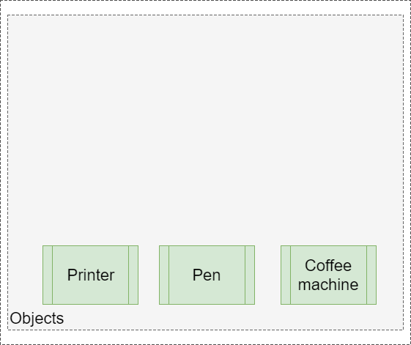
Interfaces with multi implementations

Slide 32
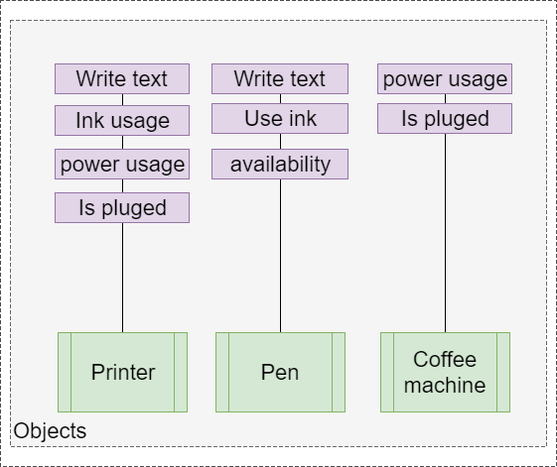
Interfaces with multi implementations

Slide 33
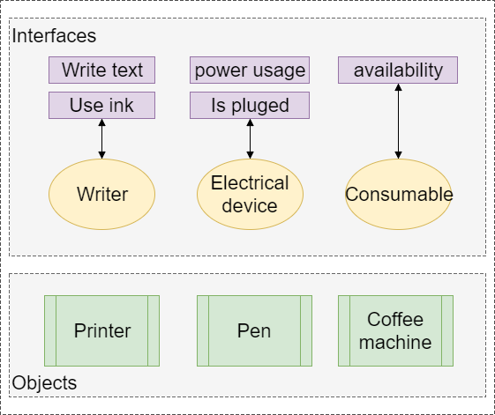
Interfaces with multi implementations

Slide 34
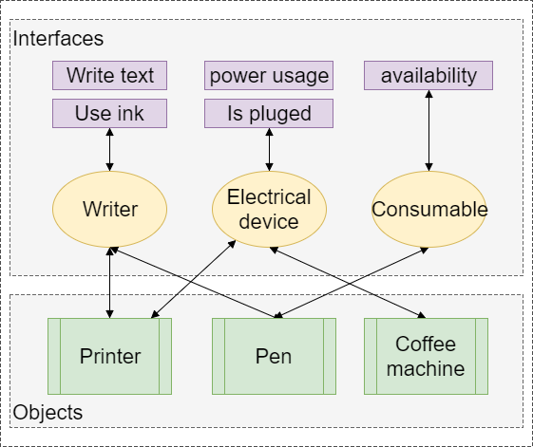
Interfaces with multi implementations

Slide 35








OOP Fundamentals
https://softuni.bg/courses/php-basics/

Slide 36
License
This course (slides, examples, demos, videos, homework, etc.) is licensed under the "Creative Commons Attribution-NonCommercial-ShareAlike 4.0 International" license
Attribution: this work may contain portions from
"PHP Manual" by The PHP Group under CC-BY license
"PHP and MySQL Web Development" course by Telerik Academy under CC-BY-NC-SA license

Slide 37





Free Trainings @ Software University
Software University Foundation – softuni.org
Software University – High-Quality Education, Profession and Job for Software Developers
softuni.bg
Software University @ Facebook
facebook.com/SoftwareUniversity
Software University @ YouTube
youtube.com/SoftwareUniversity
Software University Forums – forum.softuni.bg

